Slide 1
Tools for Data Analysis – presentation
Patrick McGrath

Slide 2
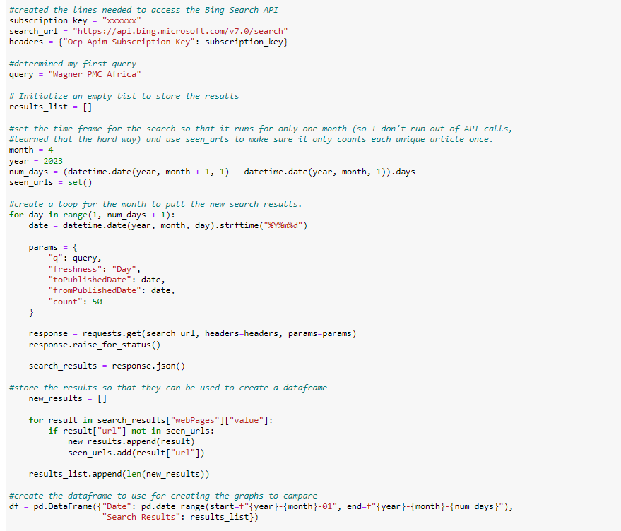
The Code

Slide 3
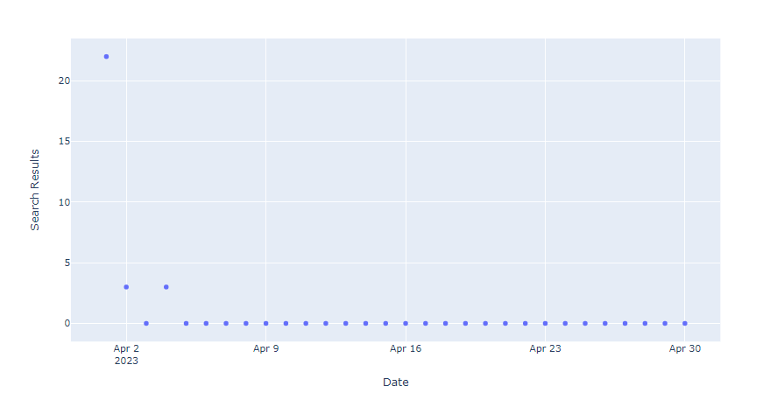
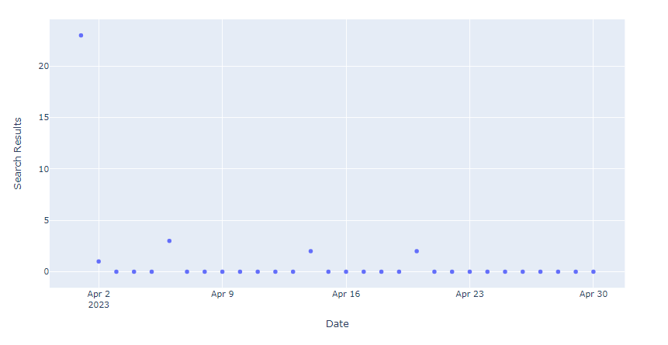
The results
"Wagner PMC Africa"
United States + Russia

